Slide 1



Our
Training Profile

Slide 2

About Us
BlueSteel Solutions is an HR business process improvement and management consulting firm, helping organizations to be significantly more efficient, effective and financially profitable.
We provide best people practices for business optimization solutions to implement process, technology & organizational improvements.
BlueSteel Solutions facilitates and enhances competitiveness through multi-faceted interventions leading to Business Improvement. This is done through consulting, process operational assessments, and quality people interventions.
Our Vision
To use Human Capital Resources in the most
Professional manner to
Build a world class
Brand

Slide 3
Core Values
We are committed to a set of core values that not only define who we are, but also aid as paths to enable us become the firm we would like to be.
Commitment to Customers
Integrity
Continuous Learning
Innovation
Passion

Slide 4



Our Services
STAFFING | CONSULTING
Focused on Hiring The Best Hands With the Best Skills To Improve Business | Focused on helping Organizations towards their journey of deploying Best Practices for Business Excellence
TRAINING | OUTSOURCING
Focused on Business Optimizations and Improvement Principles | Focused towards helping Organizations Reduce cost & Focus on core business

Slide 5

Training
Our training process for organizations looks at enhancing the performance of the staff as well as the productivity of the organization.
This is also very important as it can help in the professional development or career advancement of the employee.
Our training approach looks at;
Training Needs Identification
Content Creation
Solutions Development
Training Delivery

Slide 6



What we do
We provide sales & client management, leadership and management programmes for corporates, government and communities.
SALES & CLIENT MANAGEMENT TRAINING
LEADERSHIP & MANAGEMENT TRAINING
PERSONAL DEVELOPMENT TRAINING

Slide 7


Our Courses
We continuously adapt our existing programs and design new programs that are relevant to meet your company’s needs at every level, from the chief executives, board of management to middle managers, junior executives and administrative staff.
SALES & CLIENT MANAGEMENT TRAINING
LEADERSHIP& MANAGEMENT
PERSONAL DEVELOPMENT TRAINING
Selling skills
Action Selling
Sales Mastery
Effective sales force management
Sales Coaching
Excellent customer service
Effective telemarketing
Key account management
Supervisory Skills
Negotiating skills for sales
The Powerful Salesman
Successful customer relationship management
Learn to Lead – 1 & 2
Leadership Situation & Style
Team Leader Foundation
Team Power
Motivation Leadership
Change Management
Essential managerial skills
Master Team Motivation and Leadership
The Excutive Leader
Leading through Coaching
Train the Trainer
Effective Performance management
Management for Middle Manager
Presentation skill
Influencing skill
Communication & Interpersonal skills
Cross – cultural communication
Professional Communication skills
Train the Trainer –Basic
Planning & Time Management
Problem Solving, Delegation & Decision Making
Professional Behavioral skills
Team work skills

Slide 8

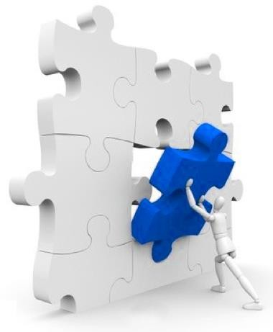
Our Approach
We start from understanding your needs and customize based on our best seller process “TCST”
Training Needs Identification
Content Creation
Solutions Development
Training Delivery
“Different learner, different learning styles

Slide 9


Methodology
Our training delivery method is involving, participative, interactive and hands-on to help participants retain the knowledge, skills, and attitudes they will learn on the programme. By doing so, the Experiential learning process of making meaning from direct experience is enhanced.
Simulation
Providing life-like scenarios through structured learning experiences to improve business awareness and management skills
Role play
Acting out situations in groups under the supervision and feedback of the lead coach.
Games
Learning can and should be fun! Using a variety of tools and games to emphasize the learning experience.
VMPT Delivery Methodology
Presentations, videos and video recording
Visual materials to support the trainers & learners
 | Case study analysis |  | Discussions
 | A key tool for such workshops, either individuals or groups review the materials provided to understand a key message. | Aristotle once said, “For the things we have to learn before we can do them, we learn by doing them.” | Using two-way communication between the trainer and the trainees to increase learning opportunities.

Slide 10



Our Commitments
To achieve your desired results, our development effort extends beyond the training room. We work in partnership with you to:
Understand your business and development needs
Design development initiatives and deliver high impact training interventions
Develop and implement powerful reinforcement programmes
Track and measure for continuous improvement and sustainability
Our methods work. They’ve been tried, tested and proven.

Slide 11


Why BlueSteel Solutions
We understand that business success starts with people.
In our approach to the market, it is our goal to focus on operational excellence, specialization and eﬃcient delivery models.
The world of work is constantly changing and BlueSteel Solutions is one of the leading forces shaping that change.
Let us help you WIN

Slide 12







www.bluesteelsolutions.com.ng
info@bluesteelsolutions.com.ng
gideon@bluesteelsolutions.com.ng
08028965971
@BlueSteelNG
BlueSteel Solutions
43 Emina Crescent, off Toyin Street, Ikeja

Slide 13



















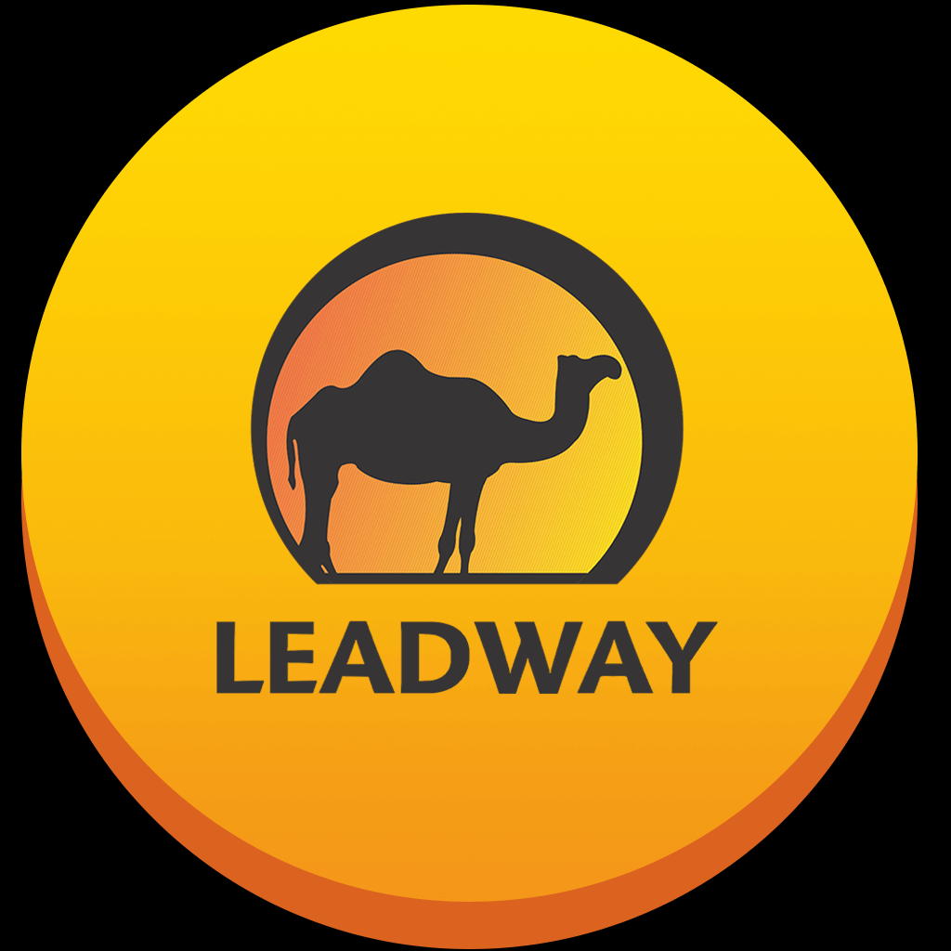




Some of Our Clients

